Slide 1


LET ThEm KNOW
Mist_five

Slide 2
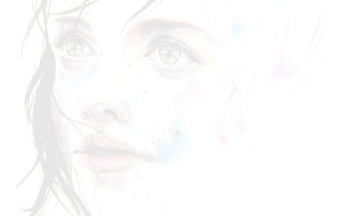
IDEA DESCRIPTION
To make women aware about their proper rights and privileges
To inform women about their health seeking behaviour in teenage , during pregnancy and in overgrown age
To ensure their primary medicare without depending on any doctor
To acknowledge women about their basic human rights and violation laws
To seek justice and try to raise women voice against violation and injustice
To inform women about general report procedure
To ensure safety of ruler women who badly seek for jobs through any agents
To keep track agents information in case of missing women/girls

Slide 3
FEATURES
Supported Language : English and Bangla Combined
Data Source : Local Database
Uniqueness: Shared preference
User Experience
Minimum Requirement: Android 2.3.3 (API 9)

Slide 4
FEATURES
Unwanted Video Removal
Health Issue
Security Issue
Hotline
Keep Records(Agent)
Trace your Agent

Slide 5

DESIGN
Click on the Icon to start the App
Splash Screen : there will appear
splash screen for 5 sec
In this Screen the icon is mainly focused
Splash Screen

Slide 6
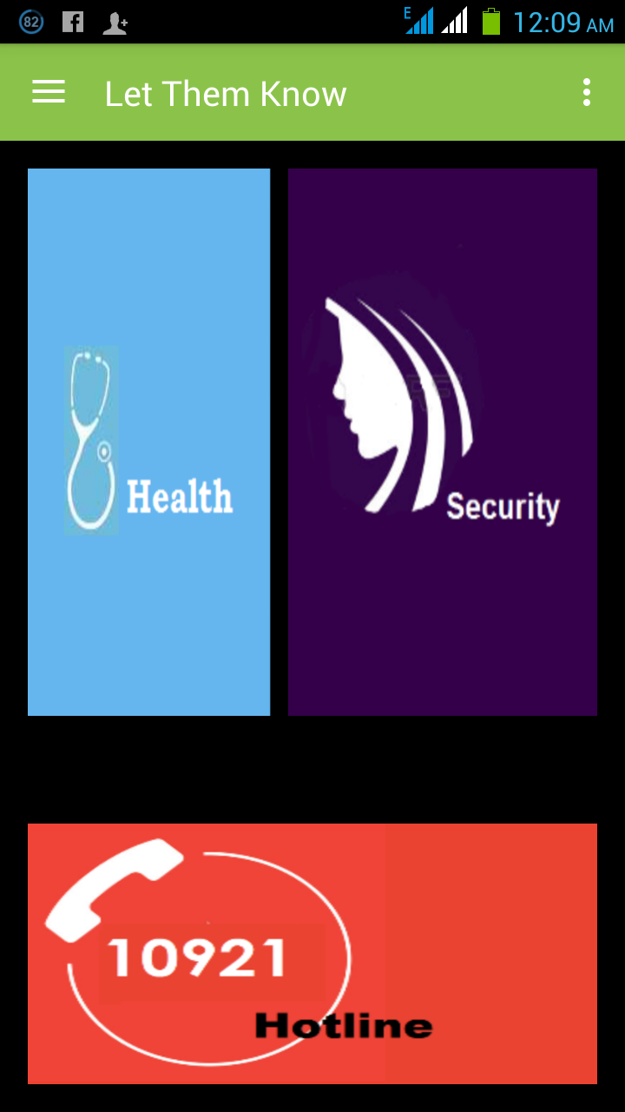
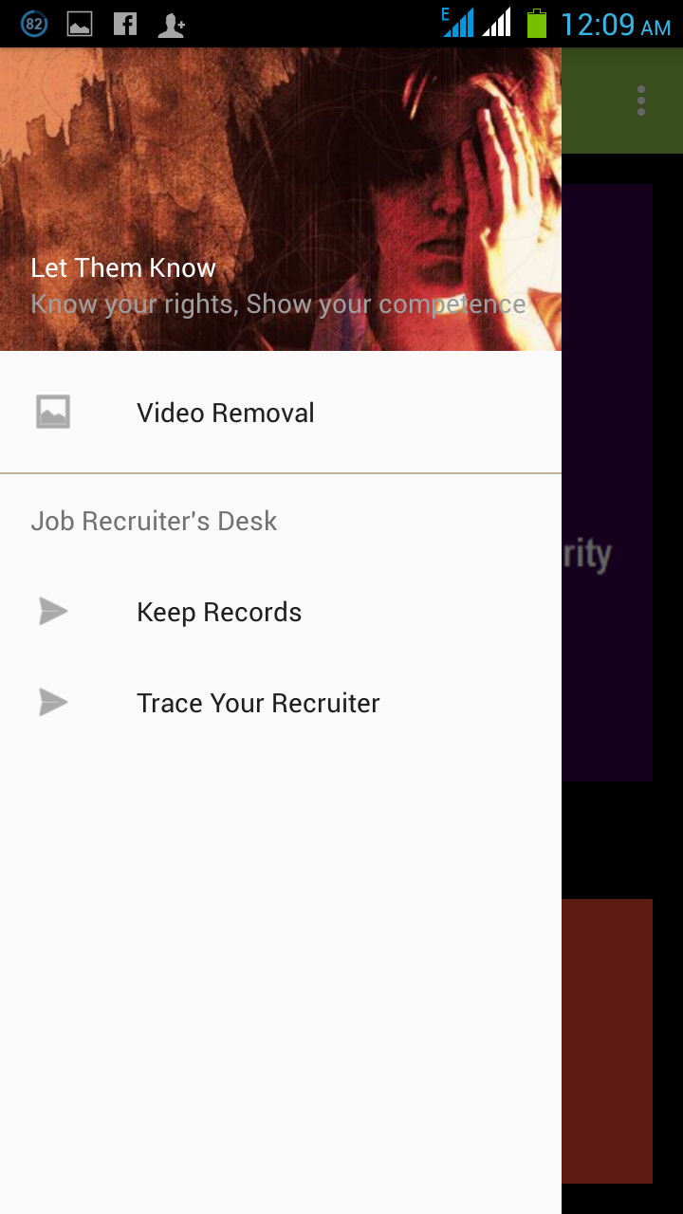
N
DESIGN
There are mainly two phases
Grid view
Navigation Drawer
Grid view
Navigation Drawer

Slide 7
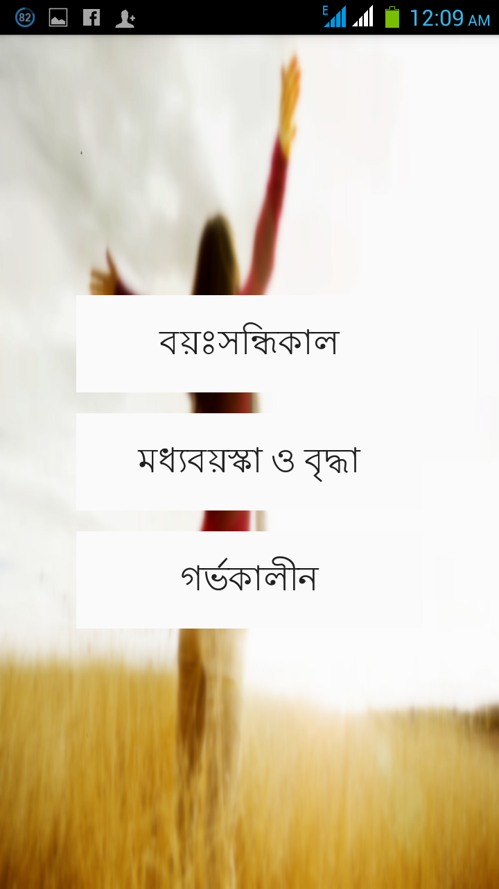
Health Issue
This feature will contain all health related problems of a woman and remedies for that respective problem.
This feature is categorized in three sub division
Teenage
Overgrown and middle aged
Pregnancy

Slide 8
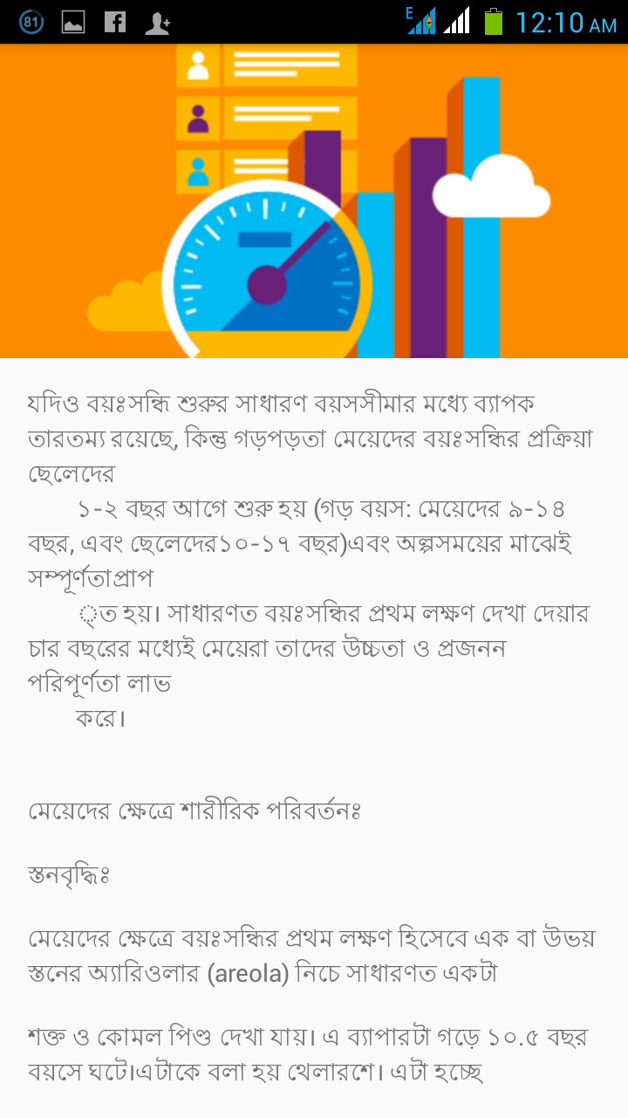
Teenage
Teenage is the most crucial point of every women’s life. In this period they face various difficulties and new challenges.
To inform teenage girls about their physical and mental growth
To acknowledge them how to cope with this situation
To ensure Medical tips

Slide 9
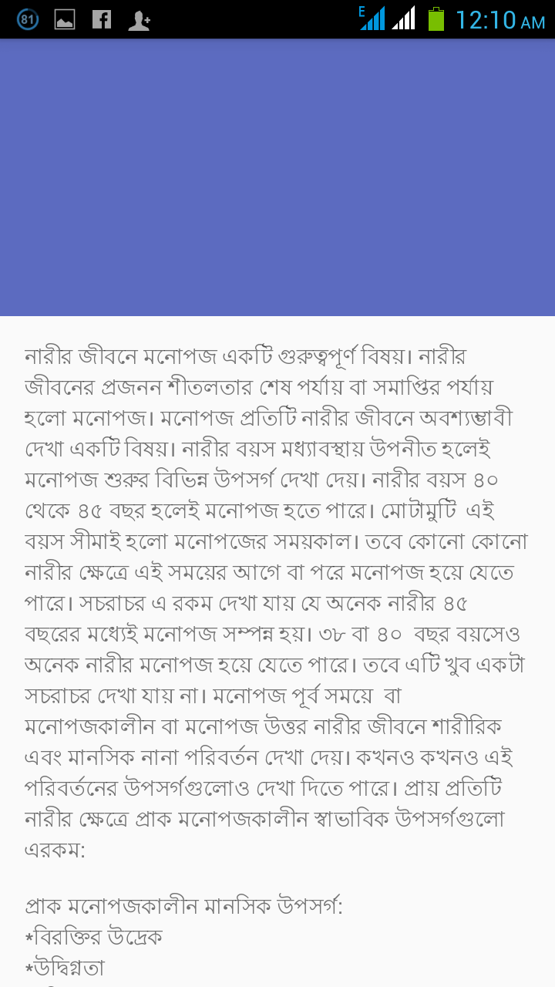
Overgrown and middle aged
In overgrown or middle age , every women need special care and proper lifestyle
To inform women about their mental change according to their behavior
To ensure their proper nutrition and diet chart
Provide Primary remedies and medical tips

Slide 10
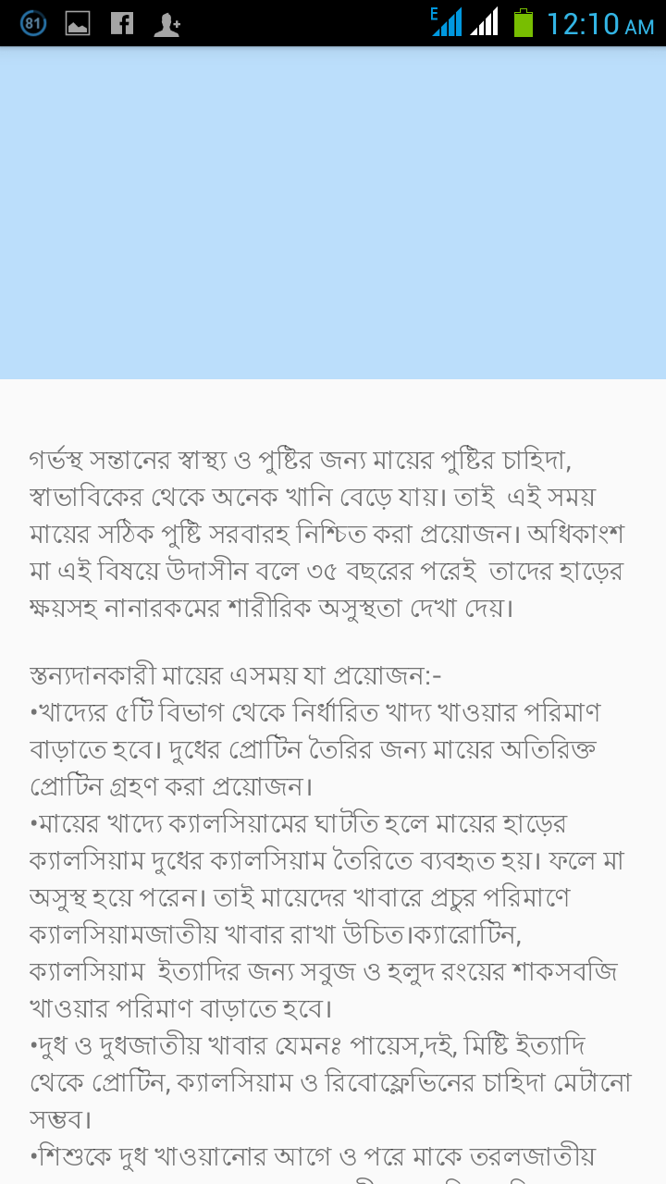
Pregnancy
During Maternity every woman needs intensive care and protection . This is the most desired and sensitive period of women’s life
To inform about precautions and necessary medical tips
Provide important information about how to take care of mother and unborn child’s health
To ensure about taking proper foods and nutrition

Slide 11
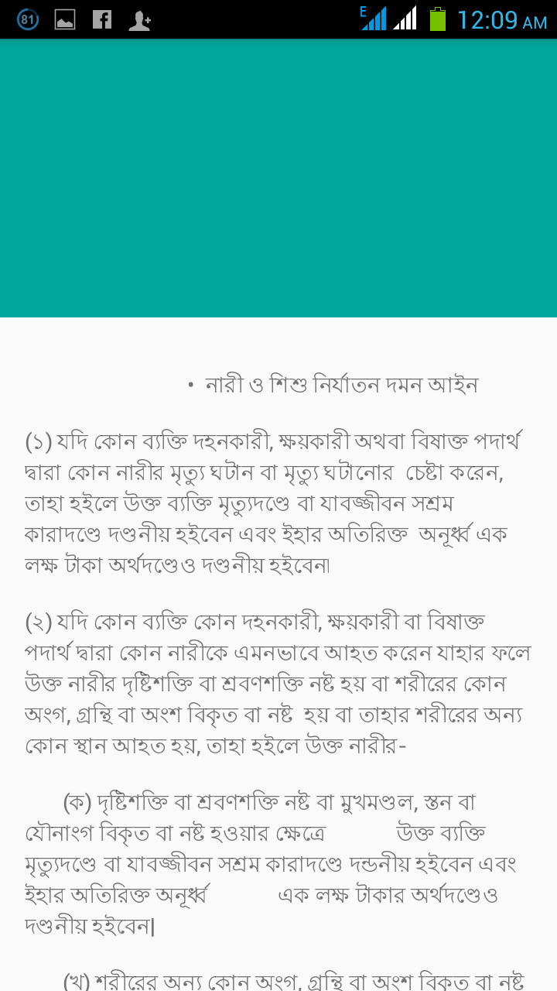
Security Issue
In this feature there will be the description of violation laws against women and the procedure of reporting
Here is added an additional criteria for self defending of women(Contact information of Karate Centres)

Slide 12
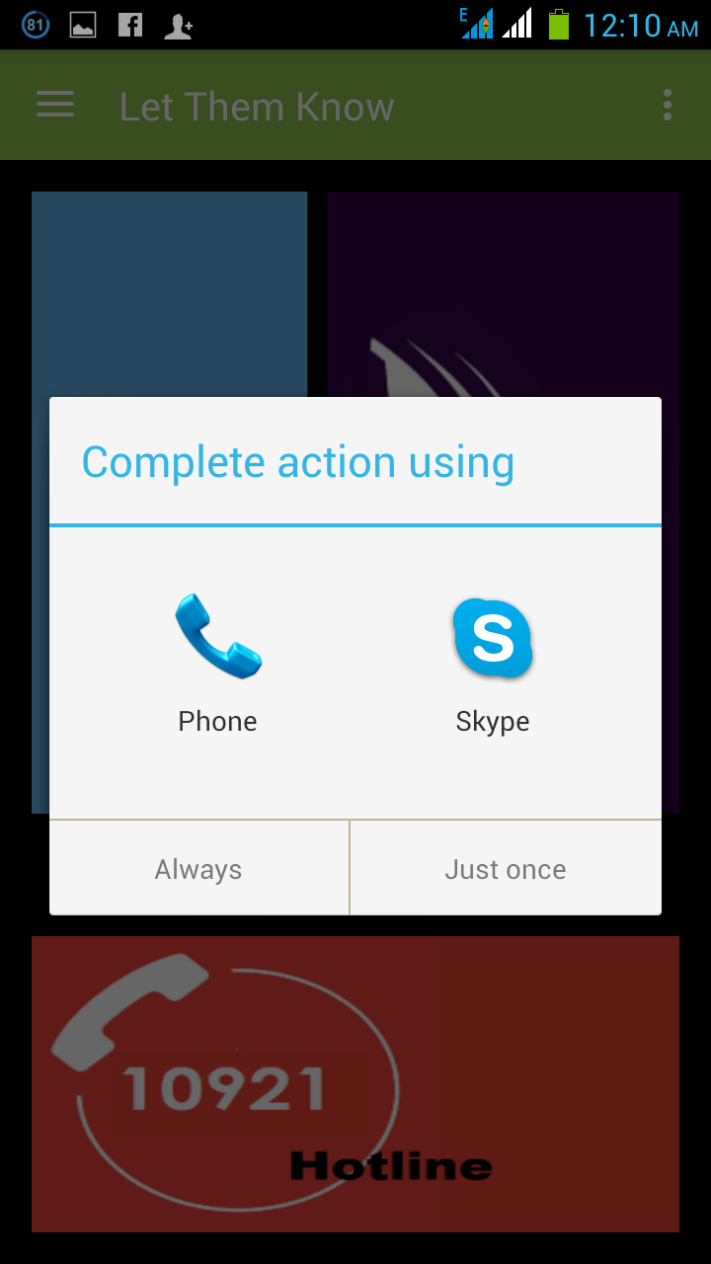
HOTLINE
If any women/girl needs emergency help such as
falling in danger
domestic violence
eve teasing
Dowry
Child marriage etc etc
then she can call to this hotline(10921) and report for any kind of help which is open 24 X 7

Slide 13
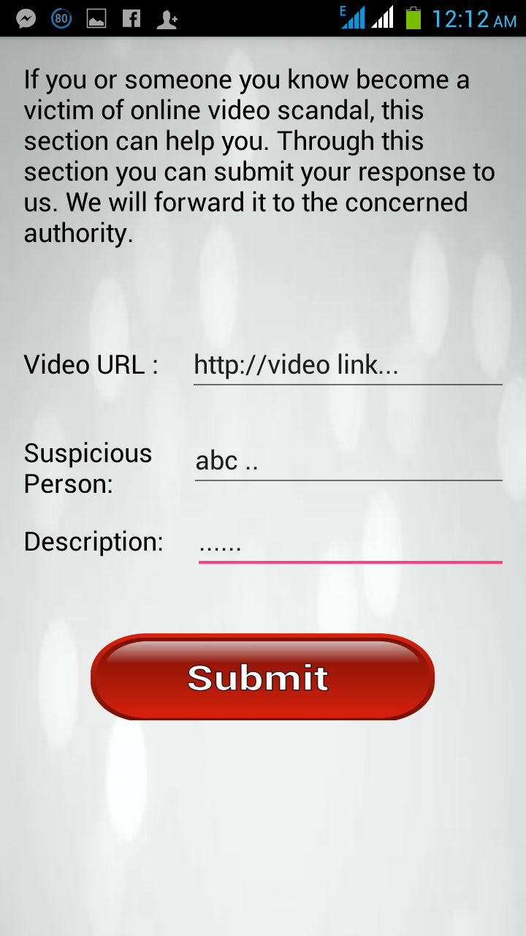
Unwanted Video Removal
Aim is to remove unwanted sexual harassing video from internet as soon as possible
To protest blackmailing the victim girl by uploading this video in internet and aware the society from humiliating the girl
To inform women/girls to report in respective cyber authority through our app and the authority will take action ASAP.

Slide 14
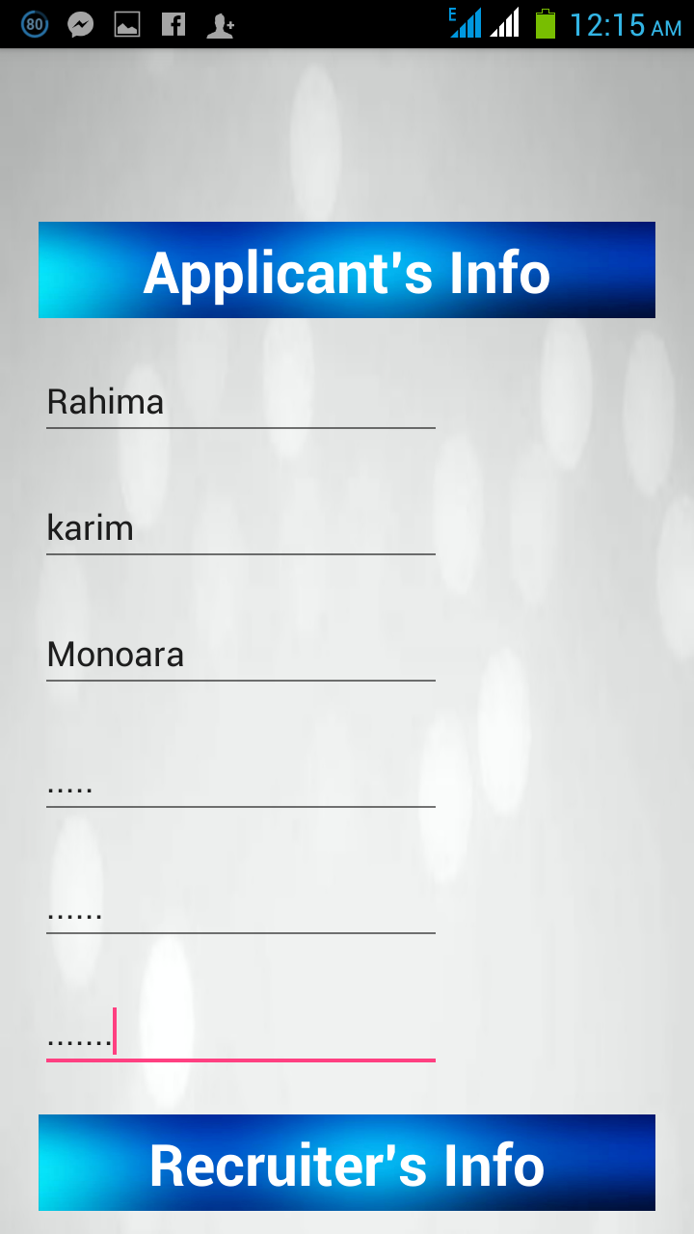
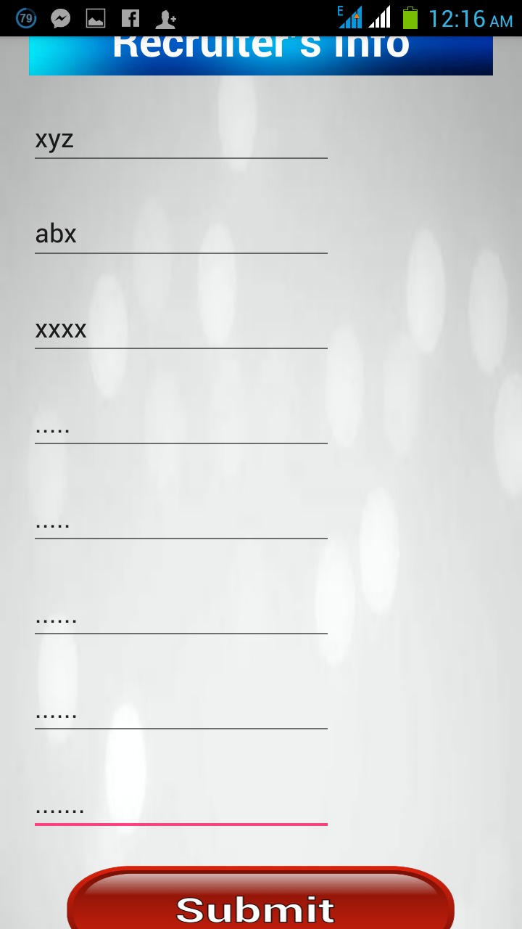
KEEP RECORDS(JOB AGENT)
Many village girls desperately seek for job and trust in any job agents who assure them to give a job. In many cases the girls are cheated and sold in brothel
Record the information of that job agent in our app’s server

Slide 15
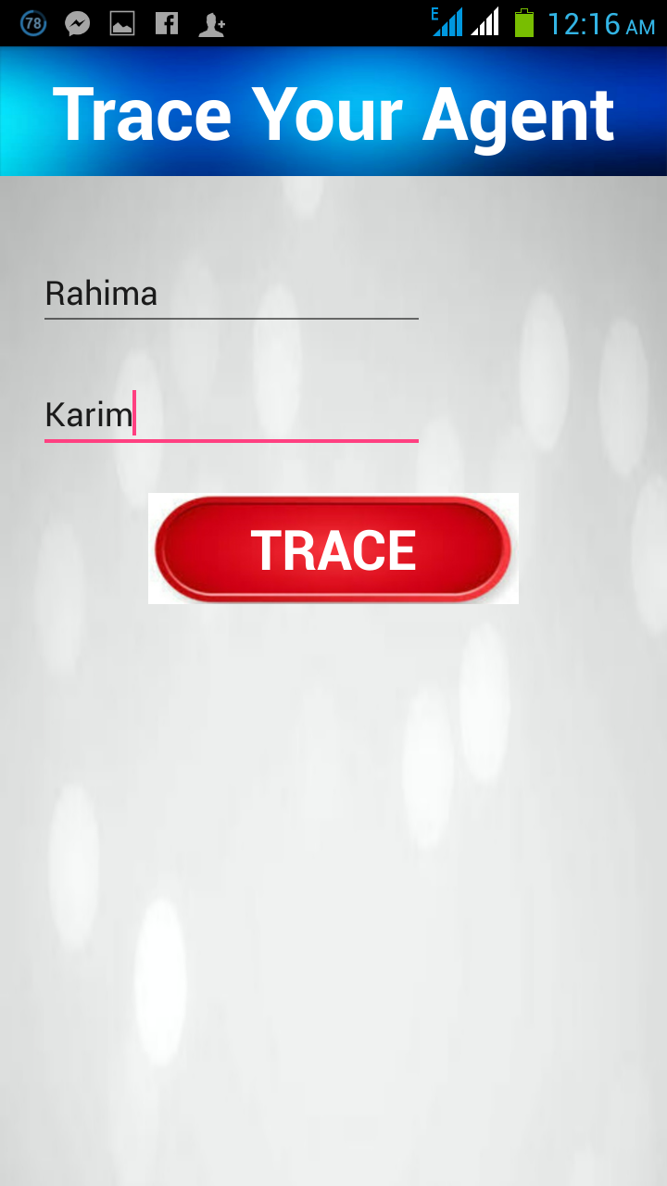
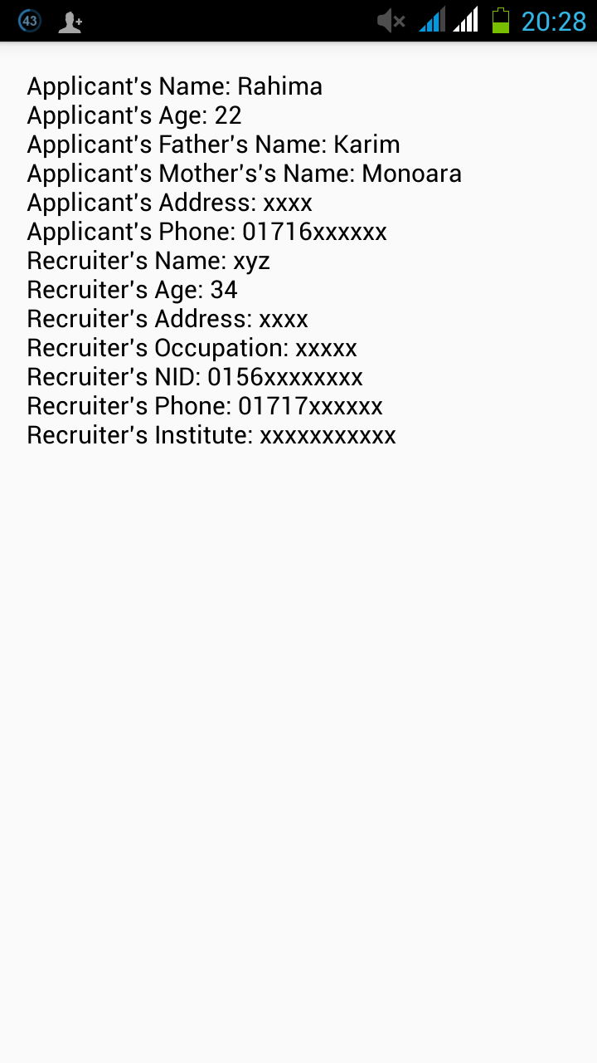
TRACE
Being fraud by any job agent, then girl’s family member can get the information about the agent through our app
To make able girl’s guardian to report in police station with that information

Slide 16
Work Distribution :
  UI Design
  JAVA coding
  Database designing & linking
  Debugging & Upgrade
Platform : Android
Database : SQLite

Slide 17
THANK
YOU

Slide 18
ANY
QUERY ???

